Slide 1
Using Social Media Data as Early Warning Signals in Risk Management
Joanne, Helen and Luna

Slide 2
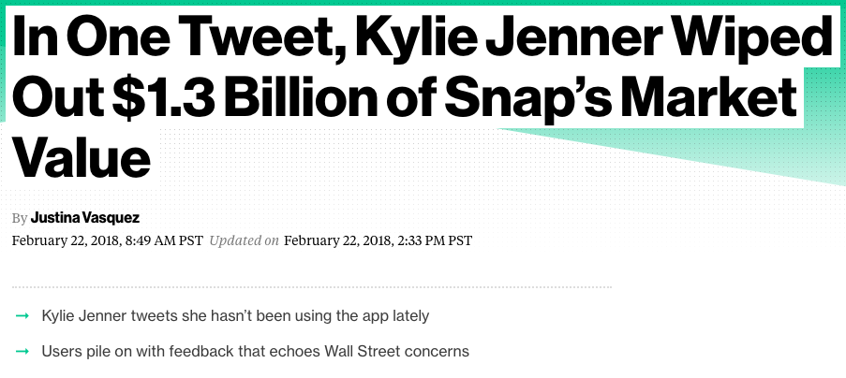
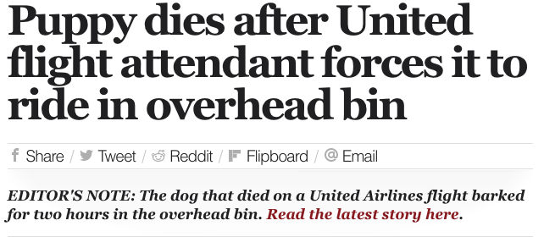
Recap: Question & Motivation
Can social media data sentiment analysis be used to predict stock trends? Do mentions of companies affect its stock value?

Slide 3
Data
Twitter tweets directed @united
Twitter API
175,000+ instances
March 7, 2018 -- March 16, 2018
Intraday (high frequency) UAL Trade Prices
Wharton Database Research Services, The Wharton School at the University of Pennsylvania
UC Berkeley Haas School of Business
1,444,514 instances
January 16 , 2018 -- March 16, 2018 (9:30 am -- 4:00 pm)

Slide 4
Literature References
Twitter sentiment analysis
Using Twitter as a source of information for time series prediction (Ramon Xuriguera, Universitat Politècnica de Catalunya)
The sentimentr Package (https://cran.r-project.org/web/packages/sentimentr/README.html)
Time series of high frequency intraday
The highfrequency Package (to aggregate secondly trade into every minute )
Intervention analysis
Time Series Intervention Analysis with R and SAS (Matt Bogard, econometricsense.blogspot)
STAT 510 9.2 Intervention Analysis (PennState)
Notes:
Use the data before the intervention point to determine the ARIMA model for the series.
Use that ARIMA model to forecast values for the period after the intervention.
Calculate the differences between actual values after the intervention and the forecasted values.
Examine the differences in step 3 to determine a model for the intervention effect.

Slide 5
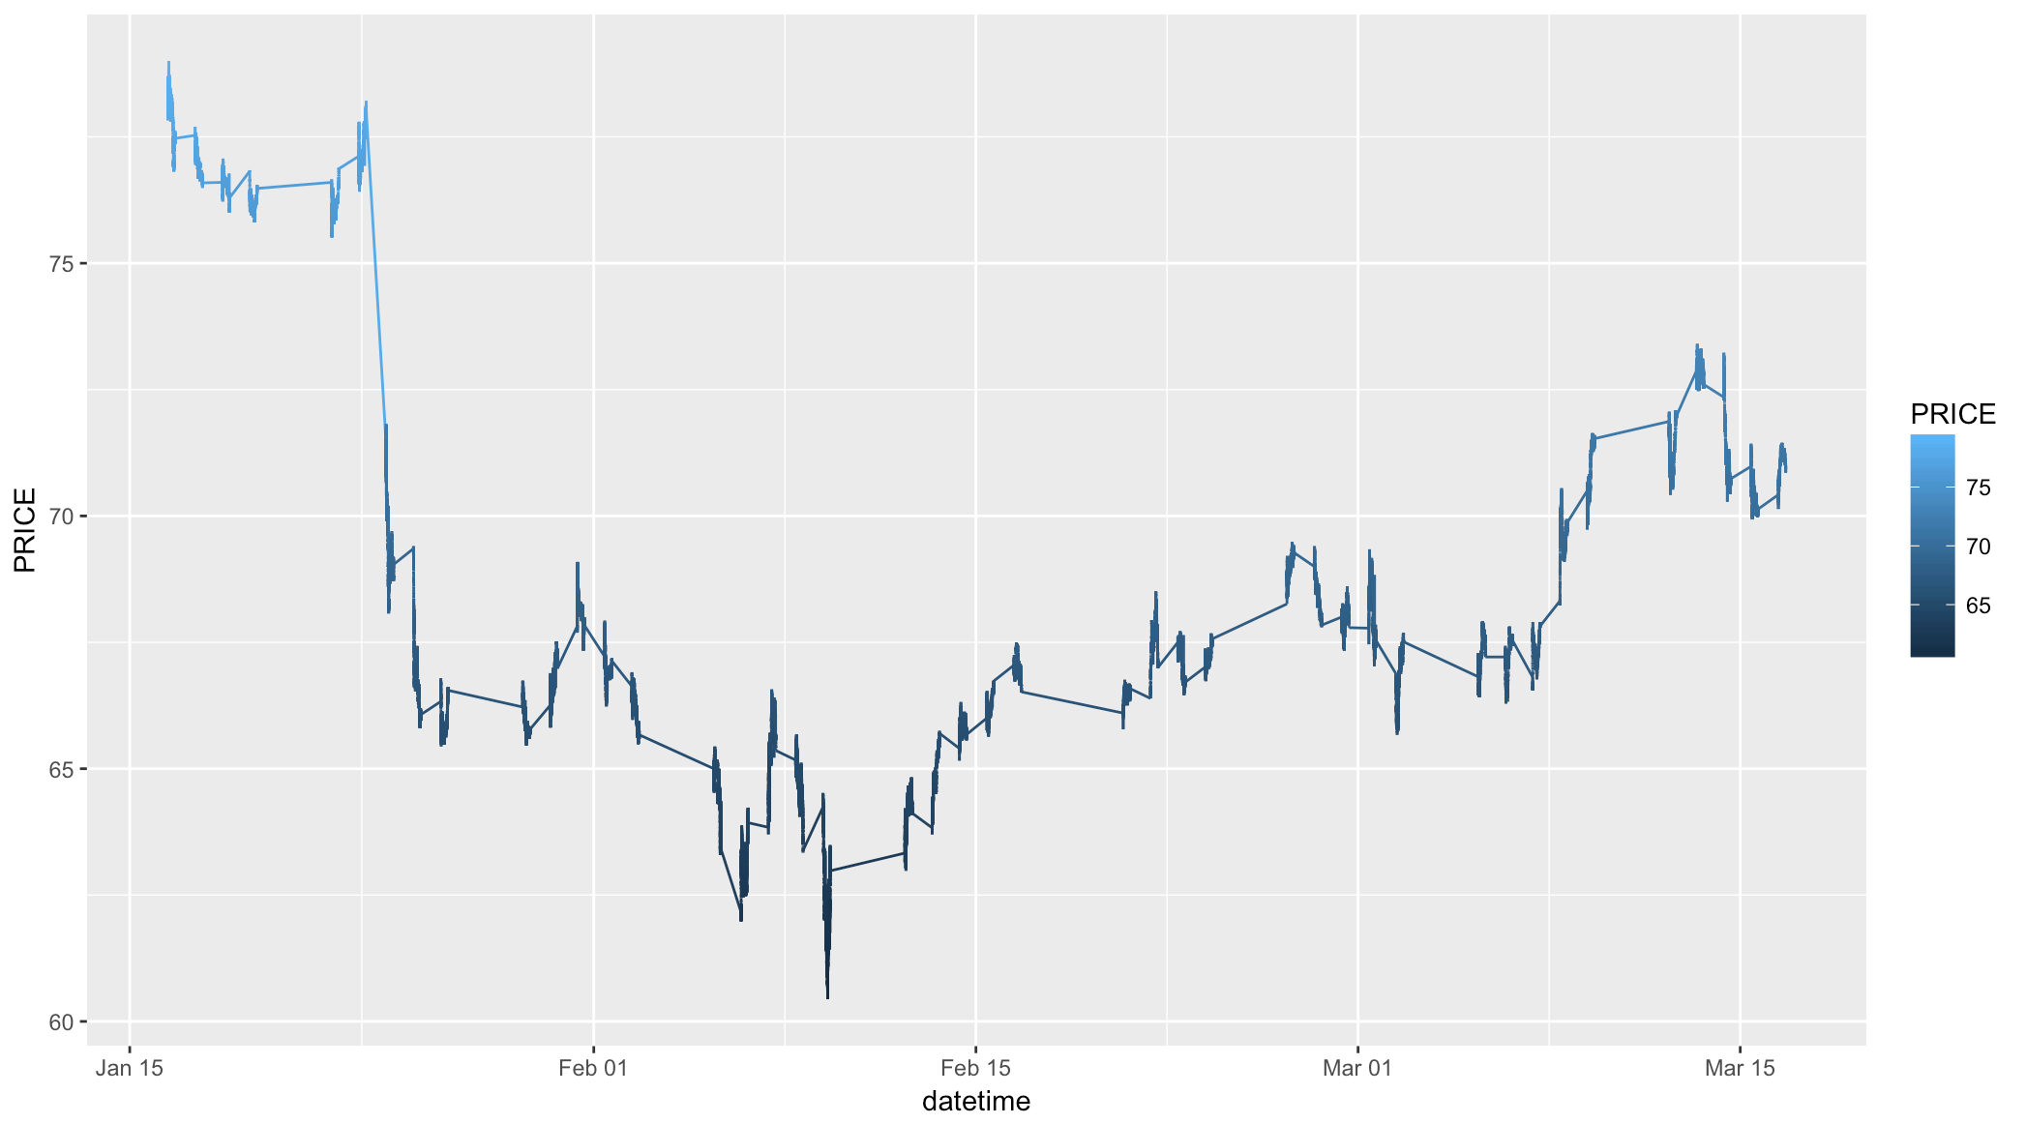
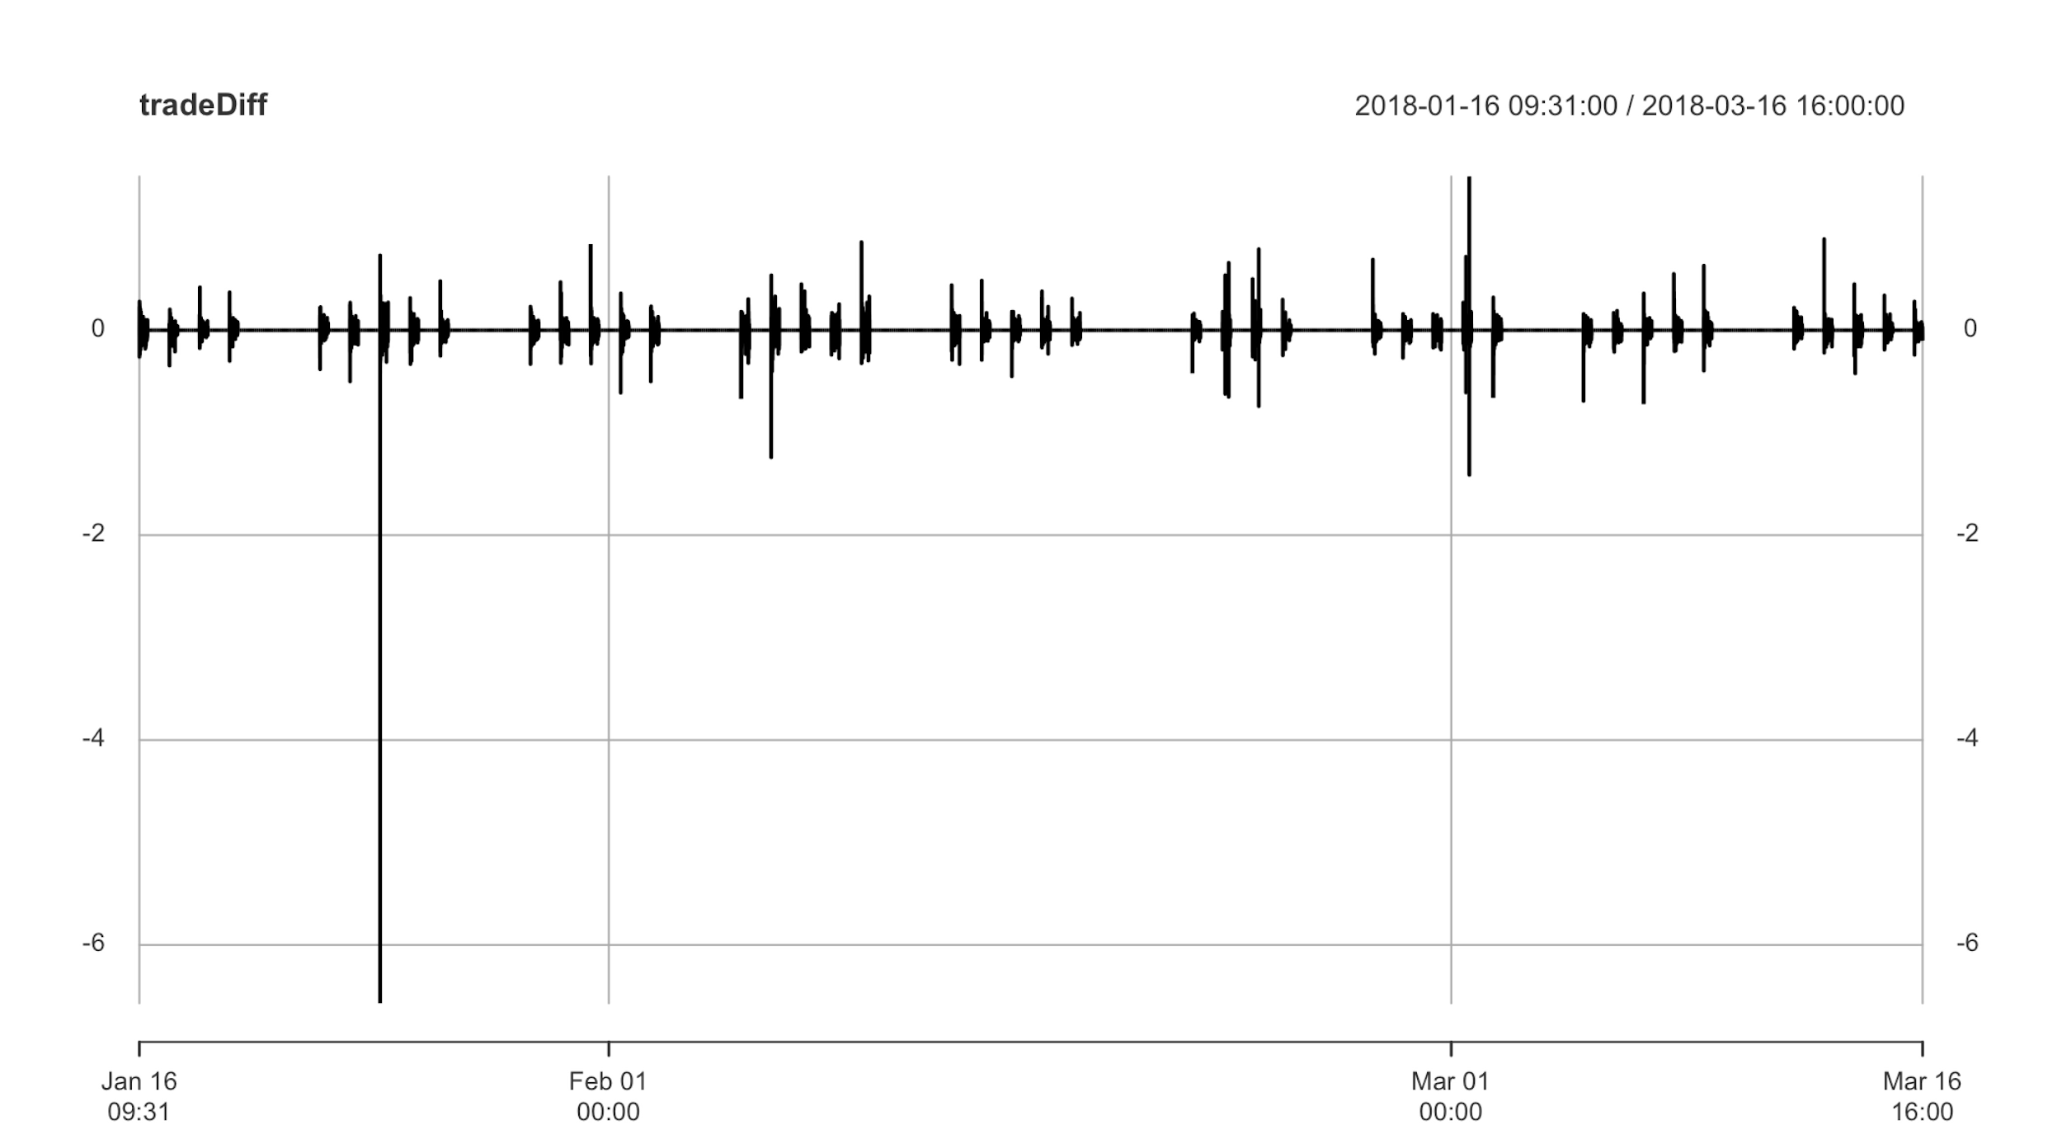
EDA and Plots
Notes:
adf.test(tradeAgg, alternative = "stationary") # check stationary p-value = 0.5136 d = ndiffs(tradeAgg) # difference = 1 tradeDiff <- diff(tradeAgg, differences = d) tradeDiff[1] = tradeDiff[2] adf.test(tradeDiff, alternative = "stationary")

Slide 6
Detailed Question - Intervention Analysis
Find intervention point from sentiment analysis
Split stock data by intervention point
Fit model on training set (data before intervention point)
Forecast data values after intervention point
Figure out intervention effect by comparing with true values after intervention point
Determine a model for the intervention effect from last step
Get overall model including intervention effect
Notes:
Start 3
Start 4

Slide 7
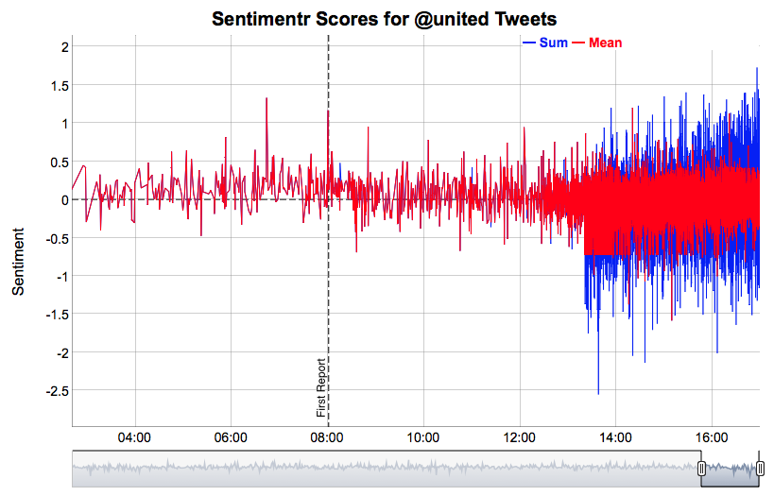
Preliminary Result - Sentiment Analysis
Results from using sentimentr package
Interactive plot using dygraphs package
Tweets are recorded in UTC time
Intervention point:
2018-03-13 15:02:00 PST
Notes:
Opinion lexicon English textfiles
sentimentr uses a much faster regex based approach that is nearly as accurate in parsing sentences with a much lower computational time. We see that RSentiment and Stanford take the longest time while sentimentr and syuzhet are comparable depending upon lexicon used.
It is a dictionary lookup approach that tries to incorporate weighting for valence shifters (negation and amplifiers/deamplifiers).
End 7

Slide 8
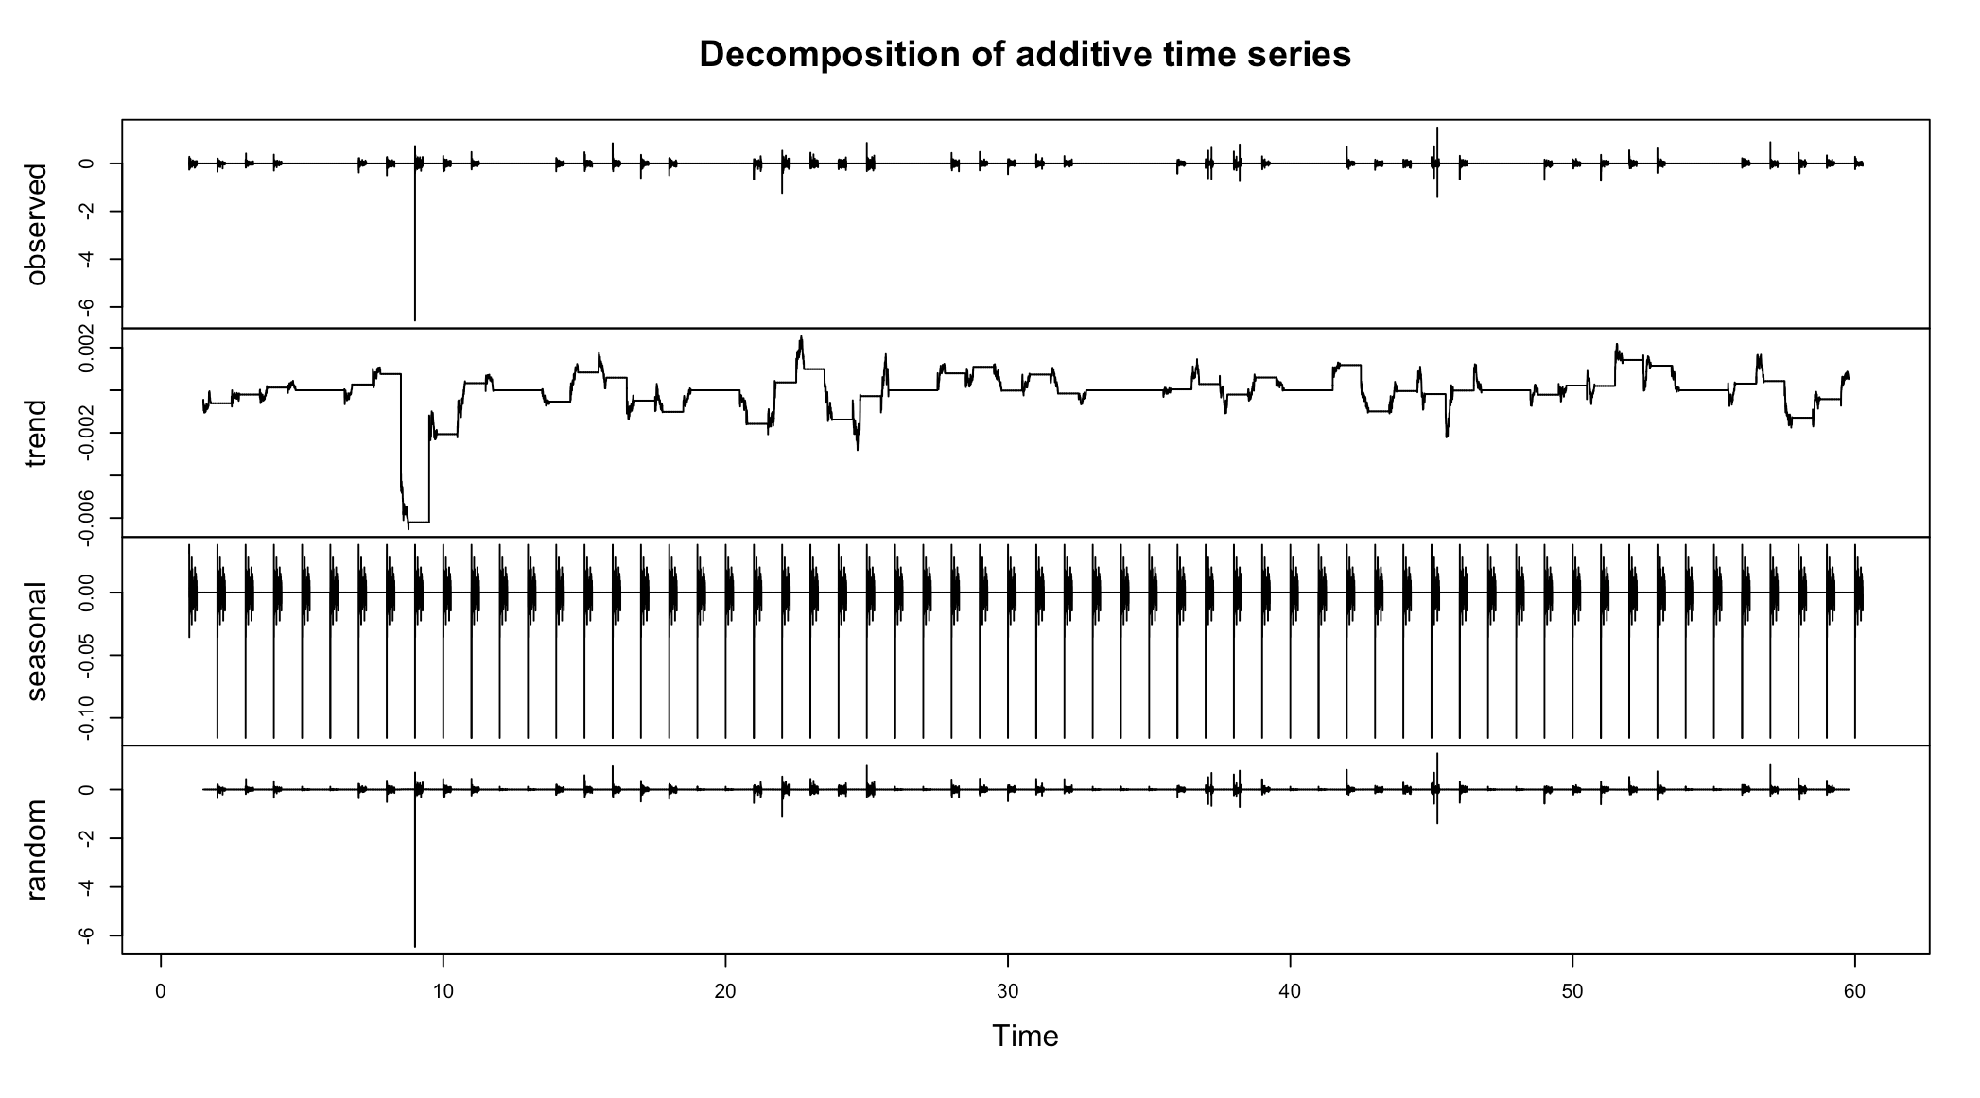
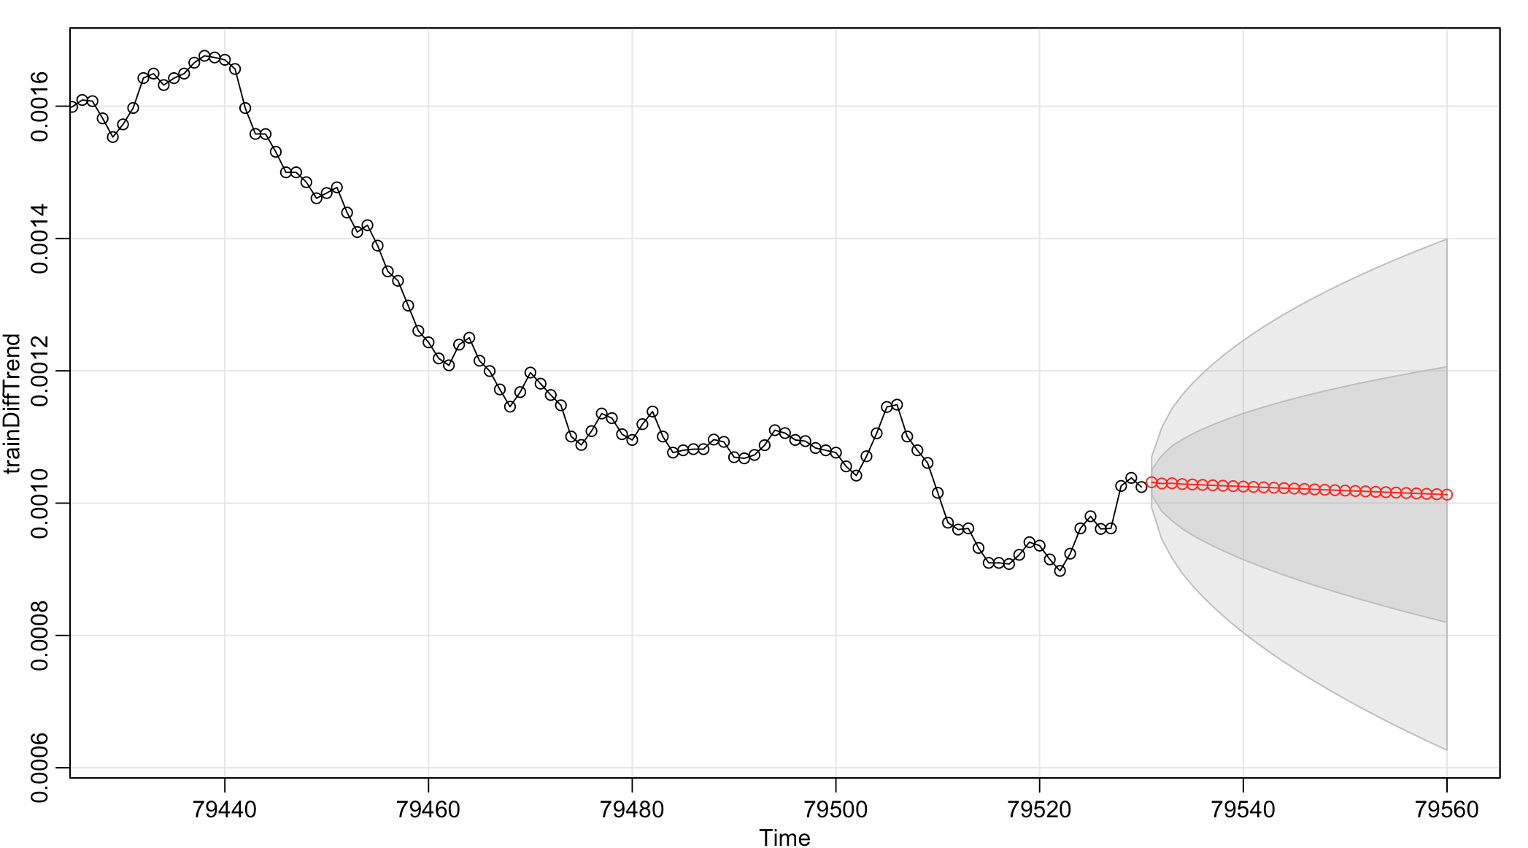
Trend Component
sarima.for(trainDiffTrend, 30, 1, 0, 4)
Notes:
Adjust seasonal
tradeDiffSeasonal <- tradeDiff2 - tradeDiffDecomp$seasonal
Use trend to de-seasonal
TSA: Start to Finish Examples (Ryan Kelly June 19, 2014)
Before using sarima model, we compared with Forecasts using Exponential Smoothing (HoltWinters), ets (models error, trend and seasonal elements together). Arima lowest AIC
sarima.for(trainDiffTrend, 30, 1, 0, 4)

Slide 9
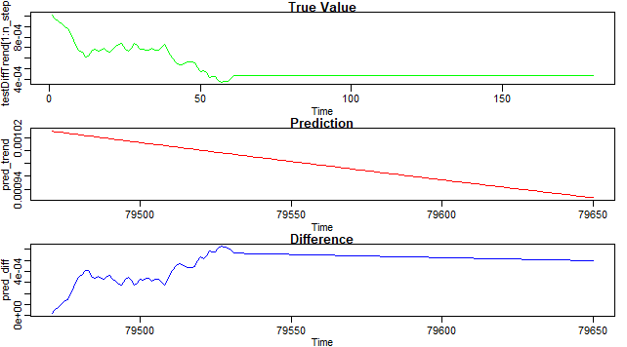
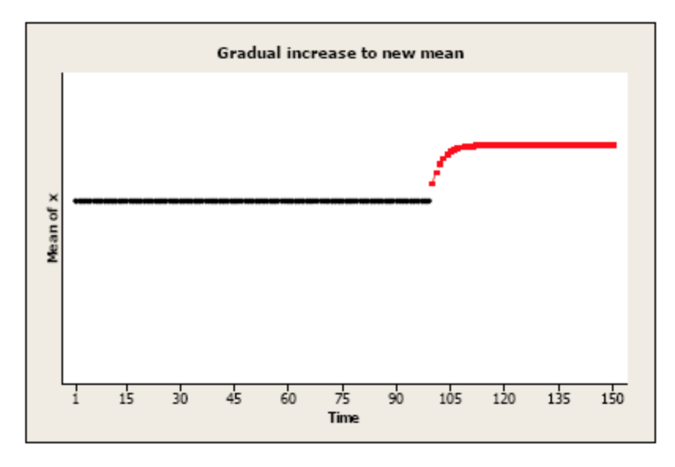
Preliminary Results - arima
Intervention point:
2018-03-13 15:02:00
Intervention Pattern:
Gradual increase or decrease to a new mean level:
c.
Notes:
Pattern of intervention
Permanent constant change to the mean level: An amount has been added (or subtracted) to each value after time T.
Brief constant change to the mean level: There may be a temporary change for one or more periods, after which there is no effect of the intervention.
Gradual increase or decrease to a new mean level: There may be a gradually increasing amount that is added (or subtracted) which eventually levels off at a new level (compared to the “before” level).
Initial change followed by gradual return to the no change: There may be an immediate change to the values of the series, but the amount added or subtracted to each value after time T approaches 0 over time.
Used arima(1,0,4) to forecast values after intervention point “2018-03-13 15:00:00”. Plot the difference between true value and prediction. Notice that the pattern looks like gradually increasing which eventually get a new mean level.

Slide 10
Future Work
Continue pulling twitter data for lasting sentiment analysis
Better model to fit stock dataset
Intervention analysis (pattern, model)
Regression using sentiment scores and tweet information as features
Notes:
Start 7
Start 9
Let z_{t} = the amount of change at time t that is attributable to the intervention. By definition, z_{t} = 0 before time T (time of the intervention). The value of z_{t} may or may not be 0 after time T.
Add a vector or matrix of external regressors like Libor did in his slides

